Slide 1


Slide 2
Laura Elliot
Belgrade Theatre
David Brownlee
Data Culture Change
Notes:
Forming, storming, norming, & performing
● Create safety: articulate what safety looks like
● Member empowerment: expectation for ownership
● Promote trust: shared agreement

Slide 3
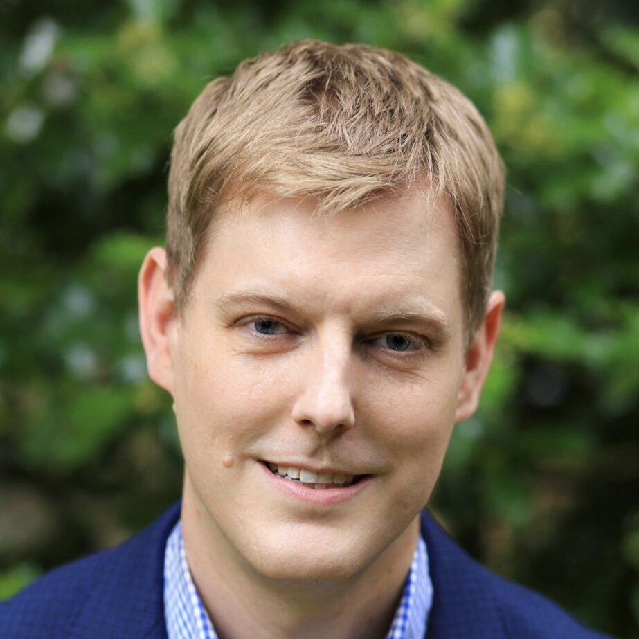
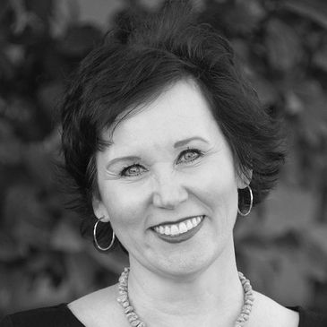
Notes:
Starting DCC – Kris Vistage for theatres conversation
Californian colleague Anita establishing new coaching company

Slide 4
Year One - 2023

Slide 5
Leaders for Culture Change Programme
You know leading change is exhausting, stressful and lonely at the best of times. And now is far from the best of times. The sector needs to find new ways of operating and change. You know it will only change if leaders like you make it happen.
Data Culture Change’s Leaders for Culture Change programme is here to be your strategic support and spur. We bring together industry experts, evidence-based strategic solutions, committed peer leaders, and a structured growth path. We will help you cut through the chaos of competing organisational demands to simplify and fortify your strategic focus.
In a cohort of no more than ten Chief Executives and Executive Directors, this intensive, year-long group coaching programme is designed to support your personal and organisational growth and help you make more effective decisions that lead to lasting change.
Notes:
Serious transformational programme, at an appropriate price

Slide 6

Notes:
Recruitment extremely challenging due ‘no competitors’

Slide 7
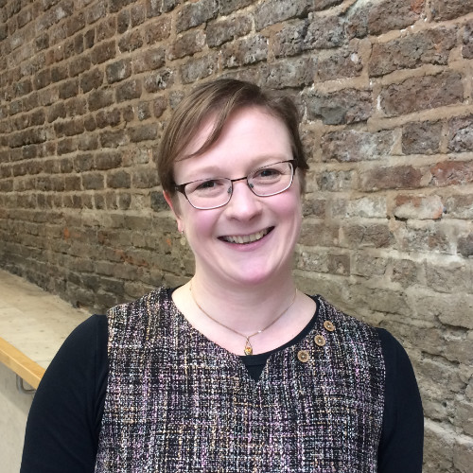
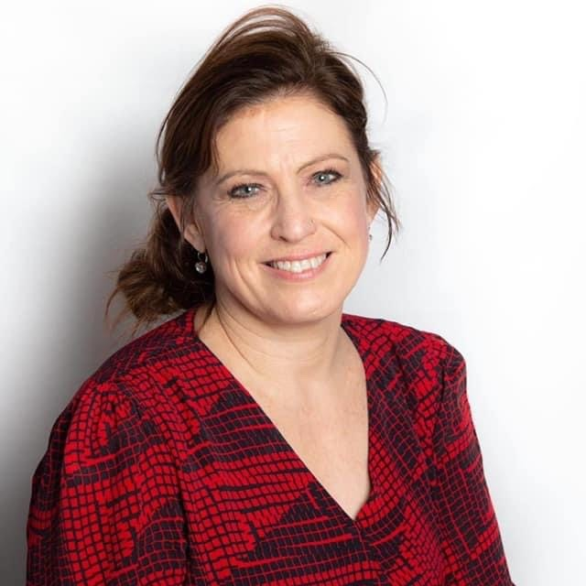
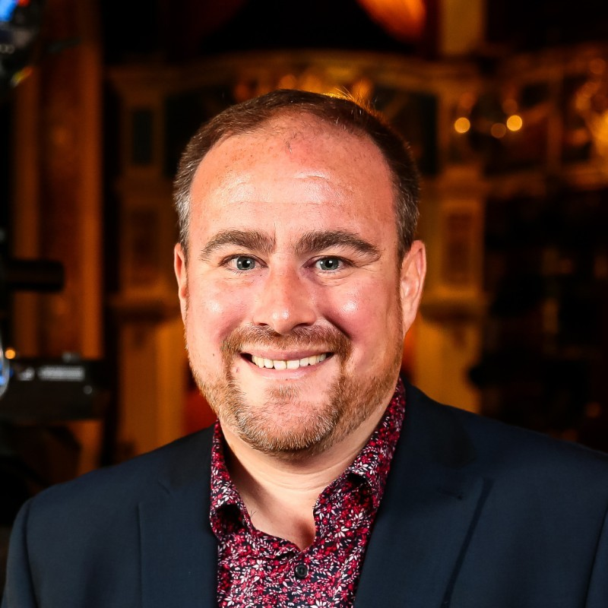
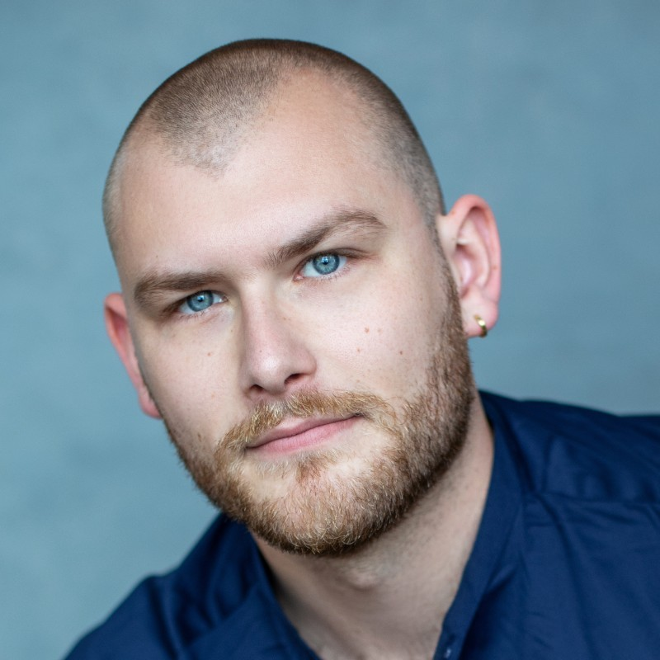
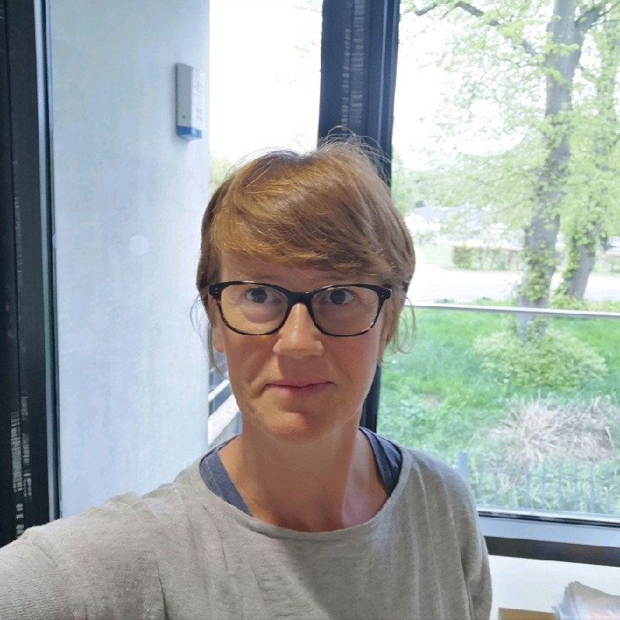
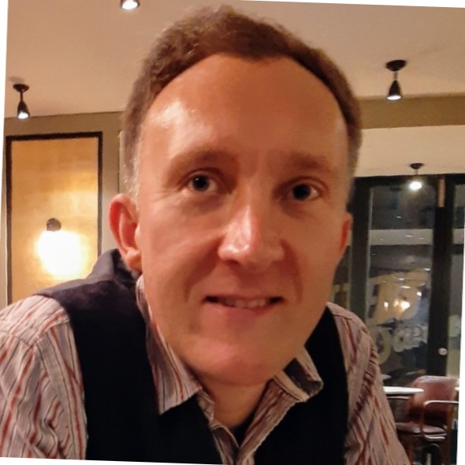
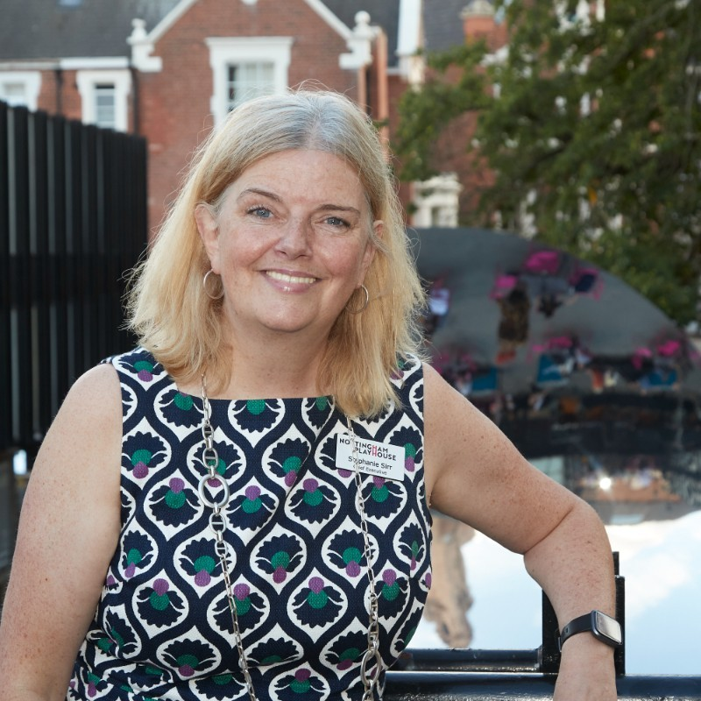
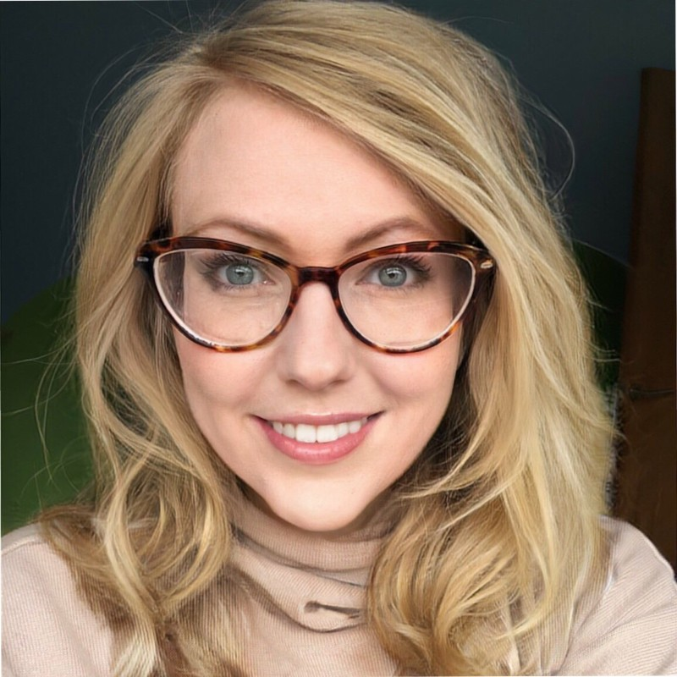
Notes:
Filled nine of the ten places.
Great mixture of leaders –
Established, new to post
Presenting/producing
Geography
NFP/Commercial

Slide 8
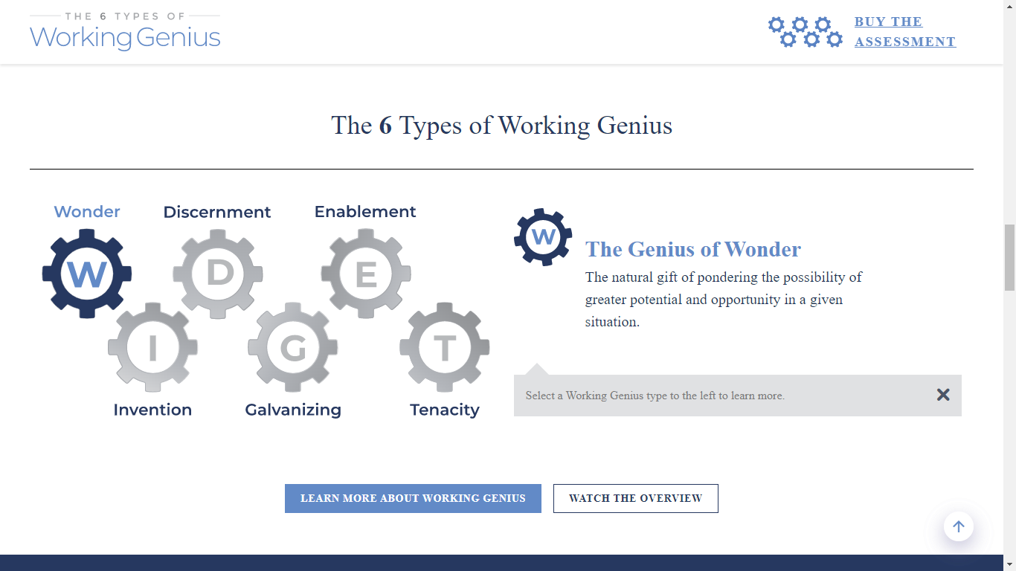
Notes:
Describe Working Genius
Share personal view on strengths and weaknesses

Slide 9

Notes:
January 2023 all travelled to Pitlochry…

Slide 10
Retreat
The programme commenced in January 2023 with a two-day leadership retreat in an attractive and relatively remote location.
The aims of the Retreat were to:
Build a trusted community with an opportunity for the cohort and the team to get to know each other
Explore issues highlighted through the Discovery phase
Commit to individual and collective leadership growth goals, for the next twelve months.
Agree programme priorities for the rest of the year. This will include selecting potential guest speakers for future quarterly Gatherings and commissioning primary research or data analysis for the programme.
Notes:
Describe how it felt

Slide 11

Notes:
Anita’s defined the pillars for a successful programme…

Slide 12
TRUST
confidentiality
SUPPORT
commitment
HONESTY
communication & authenticity
GRACE
honour we are for & with one another
Notes:
Again, personal reflection. How useful or otherwise.

Slide 13
What are the three greatest challenges facing your organisation in 2023?
Notes:
As well as WG, in the Discovery phase all participants filled in a questionnaire…

Slide 14
Expenditure
(+ income)
People
Managing Change
and Uncertainty
and...
Notes:
Remarkable alignment on issues. Surprise that climate change and EDI were not from and centre.

Slide 15
Change Manifesto
Notes:
The final key output from the Retreat was what we called a ‘Change Manifesto’, a focus for the group for the year.

Slide 16
Our Change Manifesto: Everyone should feel that their local theatre is a place where they belong
We understand theatre’s unique ability to bring communities together and change people’s lives. It provides a collective experience to which everyone has a personal response. Good theatre can transport you like nothing else, providing moments of wonder and collective joy.
Everyone should feel that their local theatre is a place where they belong. Being welcomed, recognised and respected is not enough. They should feel a sense of ownership of their civic and creative space and have the agency to influence the work it does.
We, like many theatres, work with our communities to create and programme work that is relevant. We can point to successes in engaging different groups and individuals for targeted programme and projects. Turning this short-term impact into sustainable, embedded change is a far greater challenge.
We believe that by working together this year we can start to make a difference both at our own theatres and begin to encourage change more broadly in the sector.

Slide 17
Our aim this year is to:
Heighten the sense of importance (initially within our own theatres and then in the sector as a whole) that everyone should feel theatres are a place where they belong.
To achieve this we will:
Increase our understanding of the barriers to belonging, and begin to remove them
Become more active commissioners of new work, with and for our diverse communities
Understand what models of co-creation and co-leadership with communities are truly working
Find appropriate ways to share our learning with the sector more broadly

Slide 18
Gatherings
Notes:
Day-long events with guest speakers to take forward the Change Manifesto

Slide 19
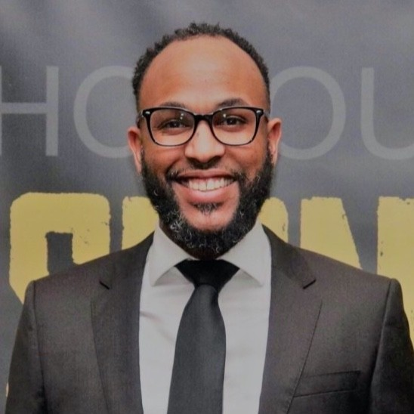
Nick Walker
University of Reading
Notes:
Nick our first…

Slide 20
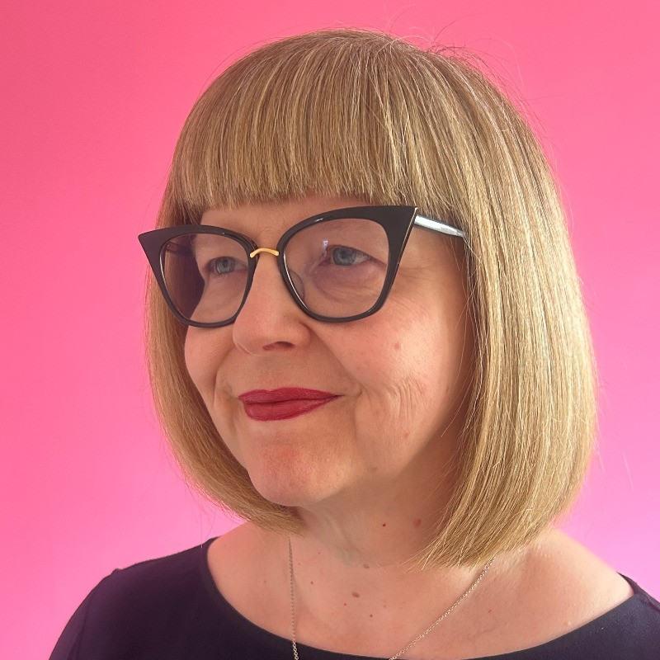
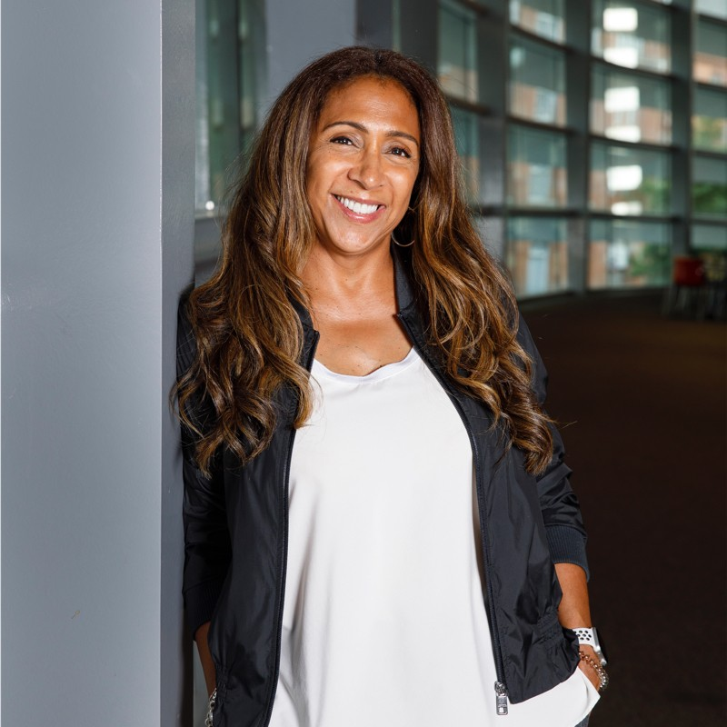
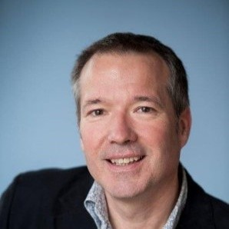
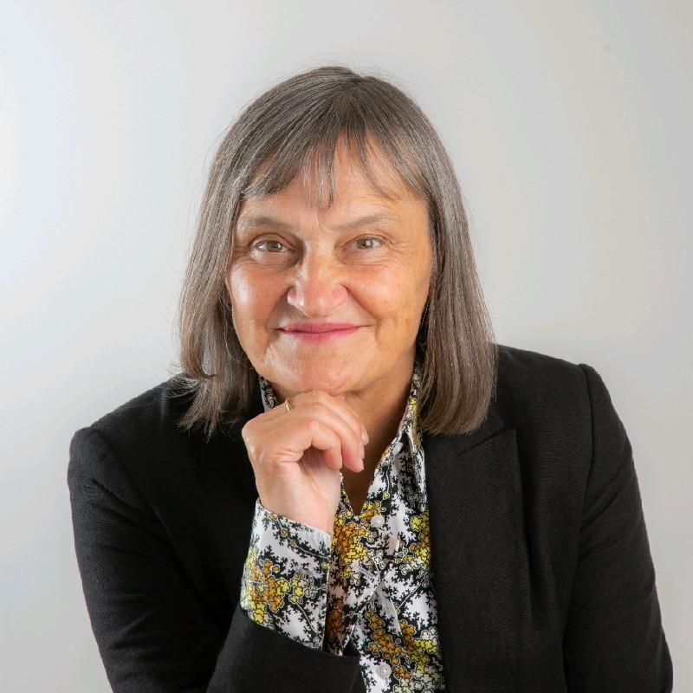
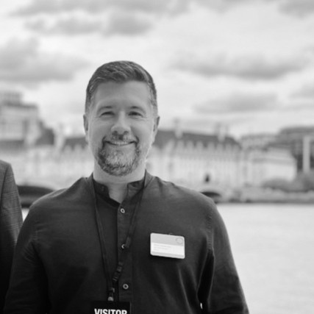
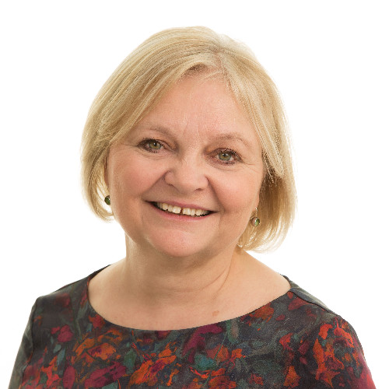
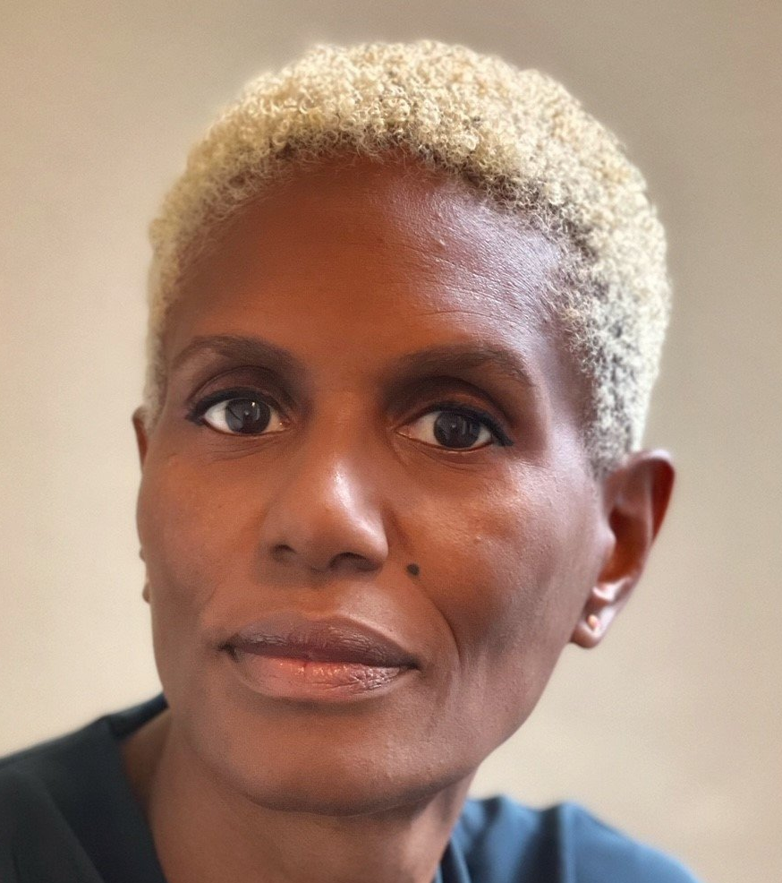
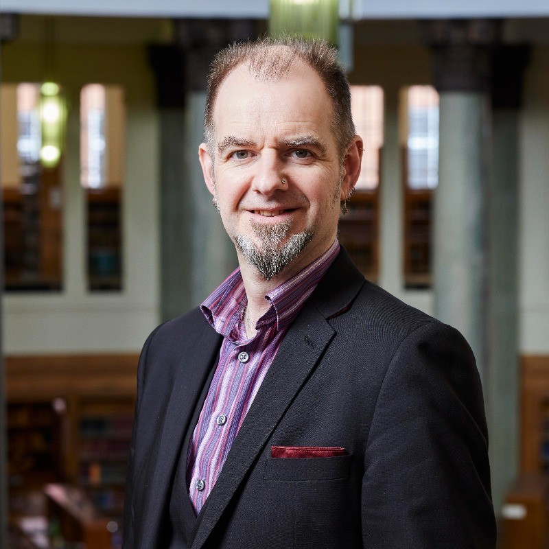
Annabel Turpin - FAC
Daniel Tyler-McTighe – Barrowful CPP
Notes:
But then lots more! Great mixture, including lots of academics. Experts very keen on talking to the group.

Slide 21
Nine months in
The greatest value is in the cohort
Time together in person is best
More joined up
Learning programme to better reflect your (changing) needs
London is easy v. not London again
One year is not enough
Budgets are limited
Notes:
Please include your personal reflections as year one was coming to a close

Slide 22
Year Two - 2024
Notes:
Forming, storming, norming, & performing
● Create safety: articulate what safety looks like
● Member empowerment: expectation for ownership
● Promote trust: shared agreement

Slide 23
Year Two
Five new members
Four Gatherings
Check-ins between meetings
Coaching an optional extra
Options to engage on projects
Far lower price point
Notes:
Again, please add your personal view of how it has felt this year.

Slide 24
The Night of your Life
Prof Peter Howarth
Queen Mary, University of London
Notes:
Festivals as Form for theatres – four organisations taking this foward

Slide 25

Notes:
Driven by three CEOs, but lots of interest.
Event last week

Slide 26
Year Three+ - 2025-?

Slide 27
Year Three and beyond
Desire to continue and grow
New theatre cohorts
Other sector cohorts
Cross-fertilisation opportunities
‘Safe space’ still essential
Commitment to sectoral change remains fundamental
We don’t have a mandate, but we can try new things
‘Think and Do Tank’

