Slide 1
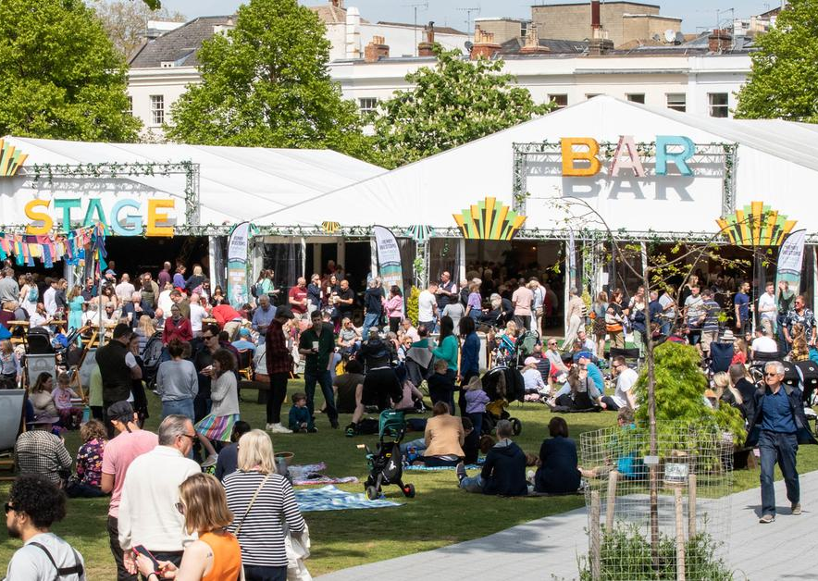
Urban Sustainability
Arts
Network
Light Up the North
Brighton Festival & Dome
Norfolk & Norwich Festival
Quays Culture
BAFA
Freedom Festival
Artichoke
Cheltenham Festivals
Festival of Thrift
Mark@nnfestival.org.uk

