Slide 1
Festivals Forward
BAFA Conference
18 November 2024

Slide 2
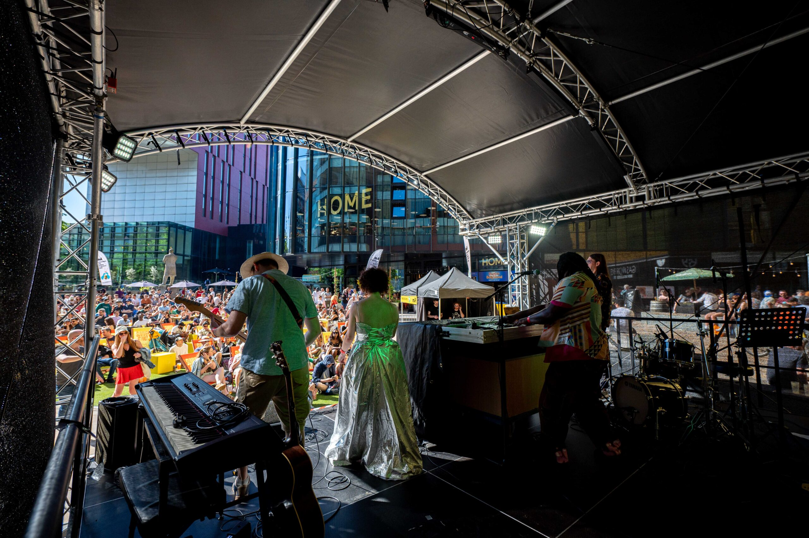
Context
A project two years in the making
Building on three previous iterations of Festivals Mean Business and developed using the previous research as a starting point
Steering group drawn from across the sector
Survey open in spring 2024 and focused on 2023 festival year
Integration of funder data to enhance and extrapolate findings

Slide 3
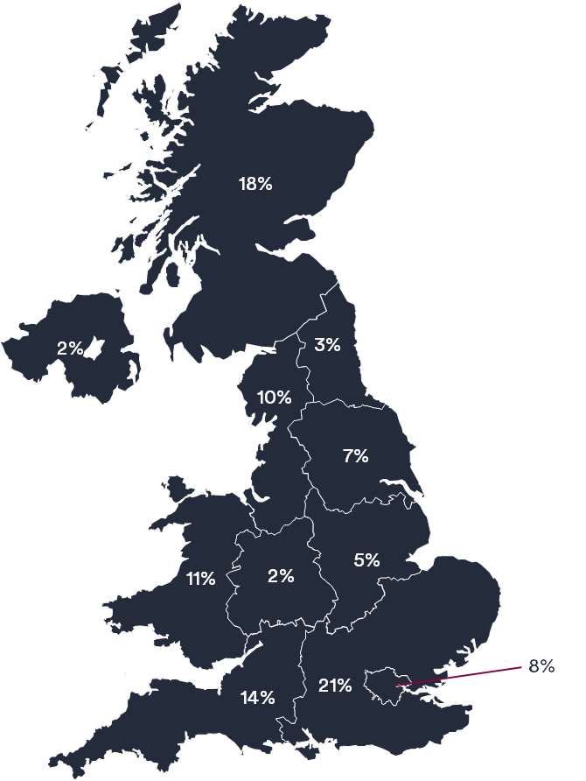
Who responded?
92 responses representing 101 festivals
Distributed across the UK
More than 20 artforms covered, as well as science festivals
Predominantly urban (61%), taking place in multiple venues (74%)
Generally annual festivals (86%), running for fewer than 10 days (58%)

Slide 4
What did we find out?

Slide 5
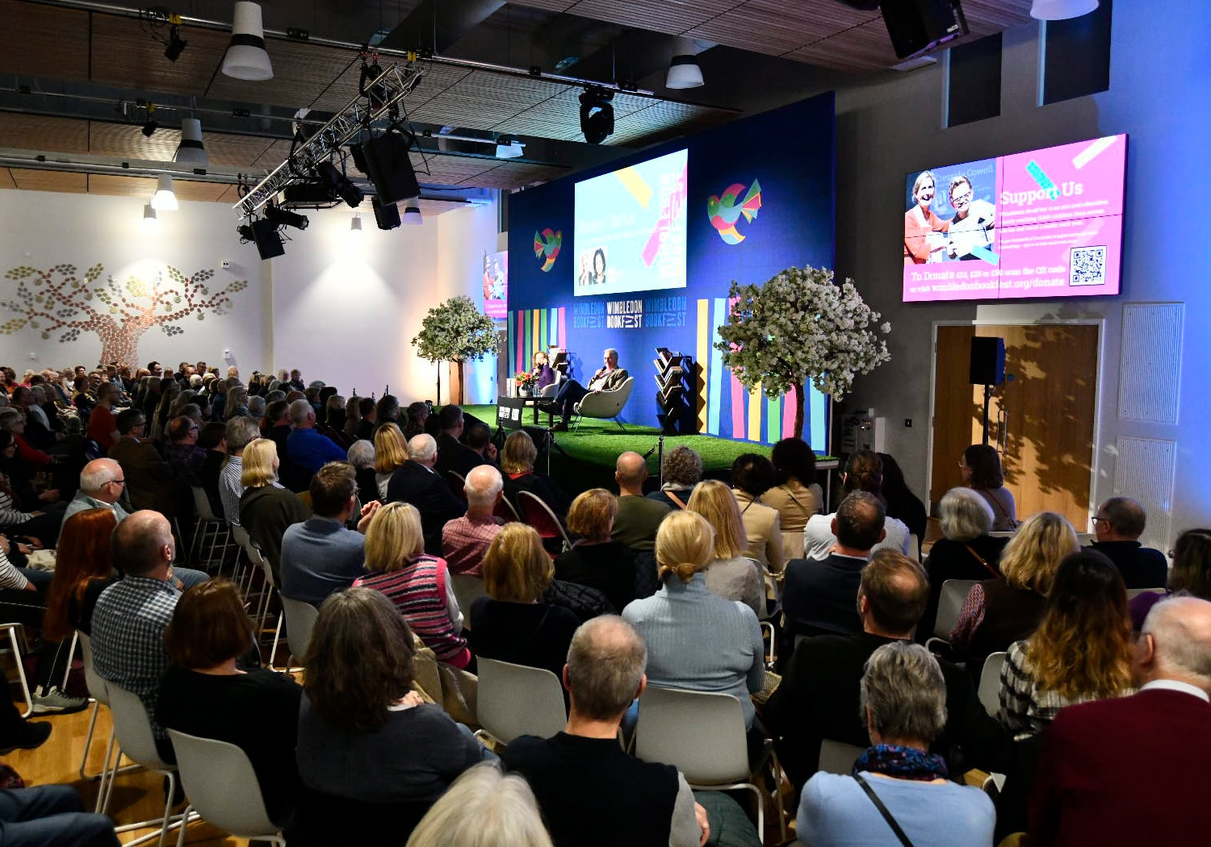





Festivals do a lot
1,111 days of activity programmed
11,500 events - equivalent to more than 30 events a day
34,000 artists and ensembles
5,560,185 attendances for ticketed and unticketed in-person events
108,287 attendances for free and ticketed online events

Slide 6
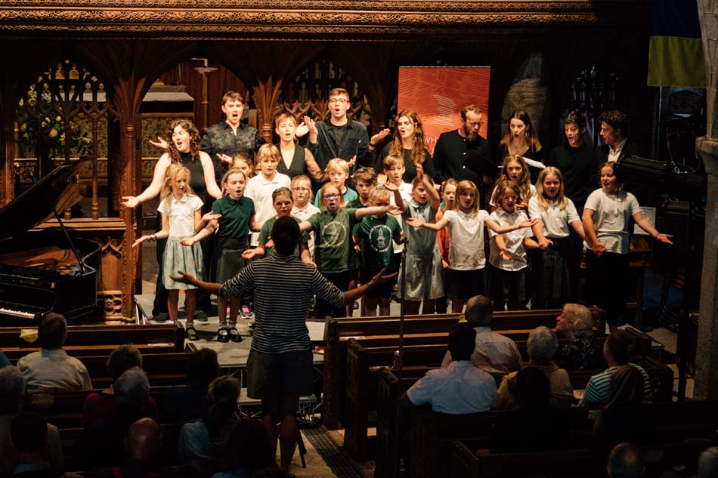




…and they do a lot more than events
86% run education and outreach activities, often year-round (83%)
Strengthen their locality; 40% of festival audiences travel less than five miles
62% presented new works, commissions, and premieres
2,700 new works, commissions, and premieres in 2023

Slide 7
They achieve all this with not a lot
Average 3 FTE employees
46% have no permanent full-time staff
4 were entirely volunteer run
4 in 5 work with freelance staff
Average of 3 freelancers per festival
500 employees year-round
Workforce increase by 1,000 employees during festivals
6,350 volunteers working across a wide range of roles

Slide 8
…and things are only getting harder
£225k
average income
£245k
average expenditure

Slide 9
…and things are only getting harder
£225k
average income
£245k
average expenditure
68% said income had stayed the same or reduced compared with 2019
24% saw income reduce by more than 20%

Slide 10
…and things are only getting harder
£225k
average income
£245k
average expenditure
68% said income had stayed the same or reduced compared with 2019
24% saw income reduce by more than 20%
64% said expenditure had grown or plateaued
28% saw expenditure grow by more than 20%

Slide 11
…and things are only getting harder
£225k
average income
£245k
average expenditure
68% said income had stayed the same or reduced compared with 2019
24% saw income reduce by more than 20%
64% said expenditure had grown or plateaued
28% saw expenditure grow by more than 20%
30% festivals reported a decrease in reserves in 2023

Slide 12
Funders play a vital role in supporting the sector
Using data provided by three of the national cultural funders we found that:
  Much more frequently funding is project based rather than regular funding
  On average festivals receive £242k per annum for regular funding vs £53k per project
Inherent limitations with project grants due to uncertainty of success and short-term nature of funding – an opportunity to advocate for more?
 | Regular funding |  | Project funding
 | Number of organisations | Value of funding (£) | Number of organisations | Value of funding (£)
Arts Council England | 50 | 10,355,465 | 306 | 12,691,626
Arts Council of Wales / Cyngor Celfyddydau Cymru | 1 | 97,500 | 19 | 8,795,036
Creative Scotland | 8 | 3,838,166 | 102 | 1,039,767
Total | 59 | 14,291,131 | 427 | 22,526,429

Slide 13
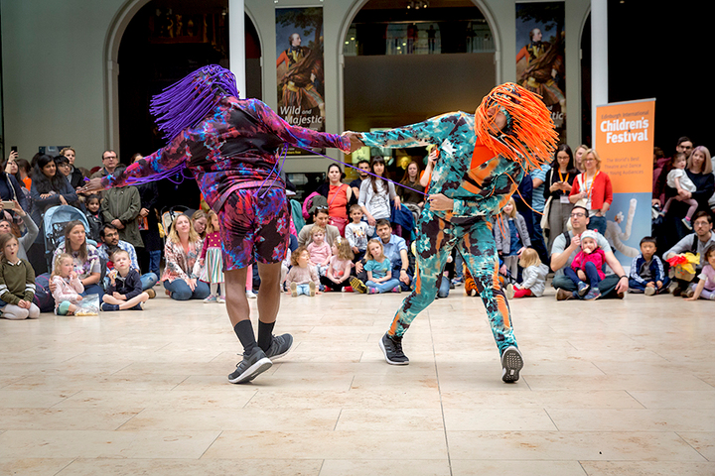
Where do we go from here?
Arts festivals are ‘surviving not thriving’
Opportunity for strategic development
  Funder level festival policies – and potentially funding
  Increasing education and training opportunities
    Bespoke to festivals
    Signposted through other cultural sector programmes
    Peer learning and exchange
Opportunity for further research
  Economic activity
  Longitudinal attendance
  Changing costs over time

Slide 14
Any questions?
rhiannon@bop.co.uk

Slide 15
Icon bank

Slide 16
Image credits
Dirty Freud at Manchester Jazz Festival, © James Darcey
Wimbledon BookFest
Whiddon Autumn Festival
Edinburgh Children’s Festival © Ruth Armstrong

