Slide 1

Stakeholder Engagement
What’s Our Message?
What Organisations have to hear it?
Who are key decision makers?
When do we get to them?
How do we get to them?

Slide 2
What Message

Slide 3
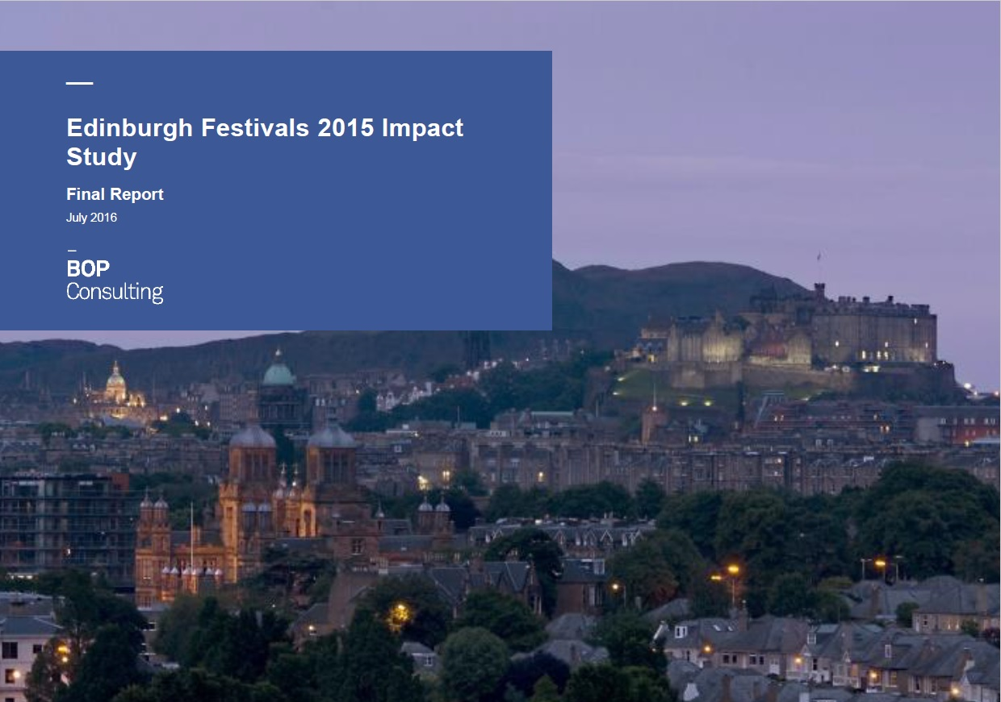
What Message

Slide 4


What Message

Slide 5
What’s Our Message?
What Organisations have to hear it?
Who are key decision makers?
When do we get to them?
How do we get to them?

Slide 6
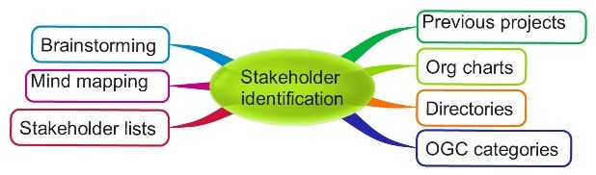
What Organisations

Slide 7
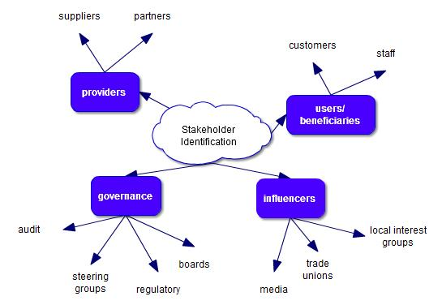
What Organisations

Slide 8
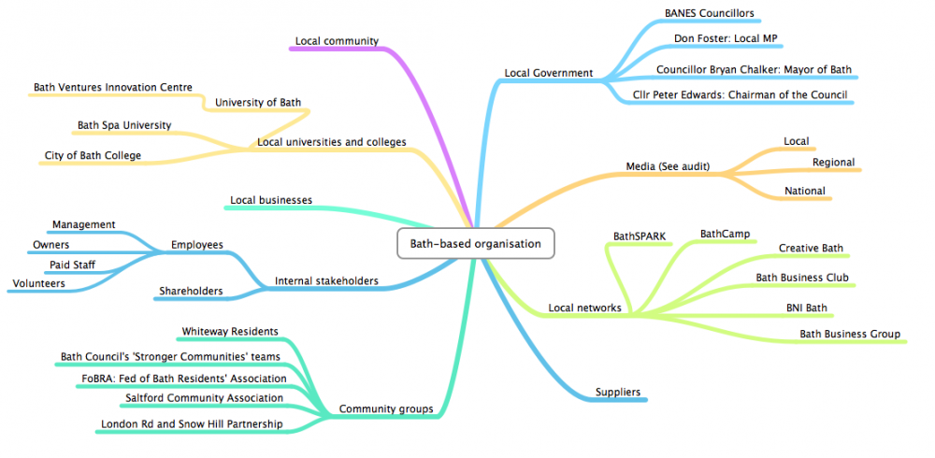
What Organisations

Slide 9
What Organisations
Festival Family
Political Sector
Funding Sector
Tourism Sector
Media Sector

Slide 10

What Organisations
Festival Forum
City policies and investment
Image
Our City
Reputation
Making the Case
Culture & External Affairs
Audiences
Policy
Focus Years
Other Policy Areas
Broader Funding priorities
Capacity
Investment
Among agencies CS, VS, ES, SDI
Skills
EXPO
Research & Intelligence
Other evaluations
TH 2
Impact Study

Slide 11

What Organisations
Festival Forum
Team Edinburgh
Our City
Reputation
Passport
Audiences
Policy
ETAG
Capacity
Investment
Informatics
SDI
Research & Intelligence
Visitor Survey
Impact Study

Slide 12

What Organisations
Knowledge Brand
Festival Forum
Momentum
Our City
Reputation
Digital
Audiences
Policy
Capacity
Digital
Investment
Knowledge Market
2016-18
Momentum
Research & Intelligence
TH 2
Making the case
Impact Study

Slide 13

What Organisations
Festival Forum
Knnowledge Brand
Our City
Reputation
Broad Cast
The Perfect Stage
Digital
Audiences
Policy
UK Market
Capacity
Knowledge Market
Digital
Investment
2016-18
Momentum
Research & Intelligence
TH 2
Making the case
Impact Study

Slide 14

What Organisations
Venues Study
Festival Forum
Team Edinburgh
Image - WLFC
International ?
City Dressing
Our City
Reputation
Making the Case
Destination
Cultural Policy
Audiences
Policy
Marketing Edinburgh
Other Policy areas
Capacity
Digital
Investment
Knowledge Sharing
2016-18
Momentum
Research & Intelligence
Impact Study
TH 2
Marketing
Comm Ed
Other Evaluations

Slide 15

What Organisations
Festivals Forum
Owning & protecting WLFC
Momentum
Knowledge
Our City
Reputation
Making the Case
International Opinion Formers
Influencing platform?
Audiences
Policy
Momentum
Capacity
Years Of……
Investment
Producers
Momentum
Research & Intelligence
CDP
2016-18
TH 2
International Working
Knowledge
Impact Study

Slide 16
What’s Our Message?
What Organisations have to hear it?
Who are key decision makers?
When do we get to them?
How do we get to them?

Slide 17
Who – Political Sector
LEADER – Cllr Adam McVey
CE – Andrew Kerr
Committees – Convenor and Members
PRIME MINISTER – Boris Johnson
CABINET SECRETARY – Sir Mark Sedwill
CABINET – Nicky Morgan
EU COMMISSION – Culture Lead
MEPs from Scotland
MSPs from Edinburgh & Lothian
Committees – Convenor and Members
Cross Party Groups
FIRST MINISTER – Nicola Sturgeon
PERMANENT SECRETARY – Leslie Evans
CABINET – Fiona Hyslop [Culture, Tourism & external Affairs]
MPs from Edinburgh and Lothians
MPs on key Committees

Slide 18
Who – Political Sector
Leader
Adam McVey
Lord Provost
Rt Hon Frank Ross
Culture & Communities Committee
Councillor Donald Wilson (Convener)
Councillor Amy McNeese-Mechan (Vice-Convener)
Councillor Mark Brown
Councillor Ian Campbell
Councillor Phil Doggart
Councillor Karen Doran
Councillor Derek Howie
Councillor Max Mitchell
Councillor Hal Osler
Councillor Susan Rae
Councillor Alex Staniforth
Education, Children And Families Committee
Councillor Ian Perry (Convener)
Councillor Alison Dickie (Vice Convener)
Councillor Eleanor Bird
Councillor Steve Burgess
Councillor Mary Campbell
Councillor Joan Griffiths
Councillor Derek Howie
Councillor Callum Laidlaw
Councillor Jason Rust
Councillor Susan Webber
Councillor Louise Young)

Slide 19
Who – Political Sector

Slide 20
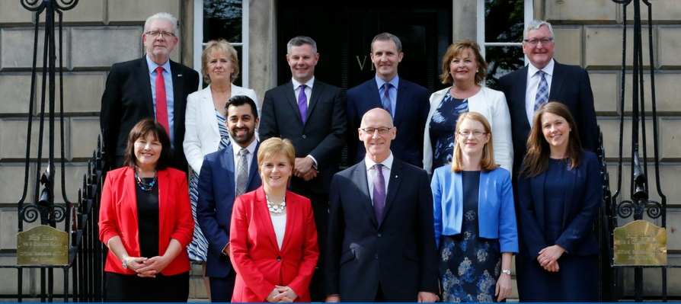
Who – Political Sector

Slide 21
Who – Political Sector
Directorate for Culture and Heritage
Culture Division
Deputy Director
Cultural Strategy and Diplomacy
Cultural Excellence
Broadcasting and Creative Industries
Creative Scotland amd Festivals
Team Leaders
Team Leader
Team Leader
Team Leader
Team
Team
Team
Team

Slide 22

Who – Political Sector
Labour Party
Leader – Richard Leonard
Culture - Claire Baker
Tourism - Claire Baker
Conservative Party
Leader - Jackson Carlaw
Culture - Rachael Hamilton
Tourism - Rachael Hamilton
Liberal Democrats Party
Leader - Willie Rennie
Culture - Eileen McCartin
Culture, Tourism, Europe and External Affairs Committee
Joan McAlpine - Convenor
Scottish National Party
Member for: South Scotland
Constituency MSPs: Edinburgh
Edinburgh North & Leith - Ben Macpherson
Edinburgh Eastern - Ash Denham
  Edinburgh Pentlands - Gordon MacDonald
Edinburgh Southern - Daniel Johnson
Edinburgh Western - Alex Cole-Hamilton
Edinburgh Central - Ruth Davidson
Economy, Energy and Fair Work Committee
Gordon Lindhurst - Convenor
Scottish Conservative & Unionist Party
Member for: Lothian
Regional MSPs: Lothian
Jeremy Balfour
Miles Briggs
Neil Findlay
Alison Johnstone
Gordon Lindhurst
Andy Wightman

Slide 23

Who – Political Sector
Speaker
Lindsay Hoyle
PM
Boris Johnson
CABINET SECRETARY – Sir Mark Sedwill
Edinburgh MPs
Edinburgh North and Leith: Deidre Brock (SNP)
Edinburgh South West: Joanna Cherry (SNP)
Edinburgh West: Christine Jardine (Liberal Dem)
Edinburgh South: Ian Murray (Labour)
Edinburgh East: Tommy Sheppard (SNP)
Cabinet
Lothian MPs
Martin Whitefield – LAB
Hannah Bardell – SNP [culture]
Civil Service
Rest of Scotland MPs
DCMS
Secretary of State – Nicky Morgan
Sport, Media and Cis – Nigel Adams
Arts, Heritage & Tourism – Helen Whately
Digital and Broadband – Matt Warman
Civil Servants

Slide 24

Who – Political Sector
Committee on Culture and Education Chair = Chair Chair - Sabine VERHEYEN helga.truepel@europarl.europa.eu
lorenzo.fontana@europarl.europa.eu
lothar.bisky@europarl.europa.eu
morten.lokkegaard@europarl.europa.eu
zoltan.bago@europarl.europa.eu
malika.benarab-attou@europarl.europa.eu
piotr.borys@europarl.europa.eu
jean-marie.cavada@europarl.europa.eu
silvia.costa@europarl.europa.eu
santiago.fisasayxela@europarl.europa.eu
mary.honeyball@europarl.europa.eu
catalin-sorin.ivan@europarl.europa.eu
petra.kammerevert@europarl.europa.eu
emma.mcclarkin@europarl.europa.eu
emilio.menendezdelvalle@europarl.europa.eu
marekhenryk.migalski@europarl.europa.eu
katarina.nevedalova@europarl.europa.eu
chrysoula.paliadeli@europarl.europa.eu
gianni.pittella@europarl.europa.eu
marie-therese.sanchez-schmid@europarl.europa.eu
marietje.schaake@europarl.europa.eu
marco.scurria@europarl.europa.eu
emilstefanov.stoyanov@europarl.europa.eu
hannu.takkula@europarl.europa.eu
laszlo.tokes@europarl.europa.eu
tudorcorneliu.vadim@europarl.europa.eu
gianni.vattimo@europarl.europa.eu
marie-christine.vergiat@europarl.europa.eu
sabine.verheyen@europarl.europa.eu
milan.zver@europarl.europa.eu
President of EU Parliament
David Sassoli MEP [France]
Secretary-General
Klaus WELLE
EU Commission President
Jean-Claude Juncker
European Commissioner for Education, Culture,
Multilingualism and Youth
androulla.vassiliou@ec.europa.eu
DG, Education and Culture
jan.truszczynski@ec.europa.eu
Head of Unit
xavier.troussard@ec.europa.eu
Ann Branch
Aviva Silver
Karel Bartak
Scotland MEPs
Alyn Smith - Scottish National Party
Christian Allard - Scottish National Party
Louis Stedman-Bryce - The Brexit Party
Sheila Ewan Ritchie - Liberal Democrats
Aileen McLeod - Scottish National Party
Nosheena Mobarik - Conservative and Unionist Party

Slide 25
What’s Our Message?
What Organisations have to hear it?
Who are key decision makers?
When do we get to them?
How do we get to them?

Slide 26
How do we get to them
 | Impact on
Stakeholder Group | Finance | Programme | Planning | Promotion
Sponsor - 1 | 
Media - 2 |  |  |  | 
Politician - 3 |  |  | 

Slide 27
How do we get to them
High
SATISFY NEEDS
- Engage and consult on interest area / Try to increase level of interest
MANAGE CLOSELY
- Key players/ involve in decision making or governance / engage regularly
INFLUENCE
MONITOR
- Inform via general communications
CONSIDERATION
- Involve in low risk areas / consult on area of interest / use as good will ambassador
Low
Low
High
INTEREST

Slide 28
How do we get to them
Stakeholder Group | Goals | Influence | Interest | Action | Strategy
Sponsor - 1 | Increased brand recognition through high visible projects top target markets | Low | High | Consideration | Regular updates and clear channels
Media - 2 | Maintaining a positive image and promoting the festival | High | Low | Satisfy Needs | Partner in development of comms plan
Politician - 3 | Successful delivery against funding requirements | High | High | Key Player | Sign off of key decisions and stages

Slide 29
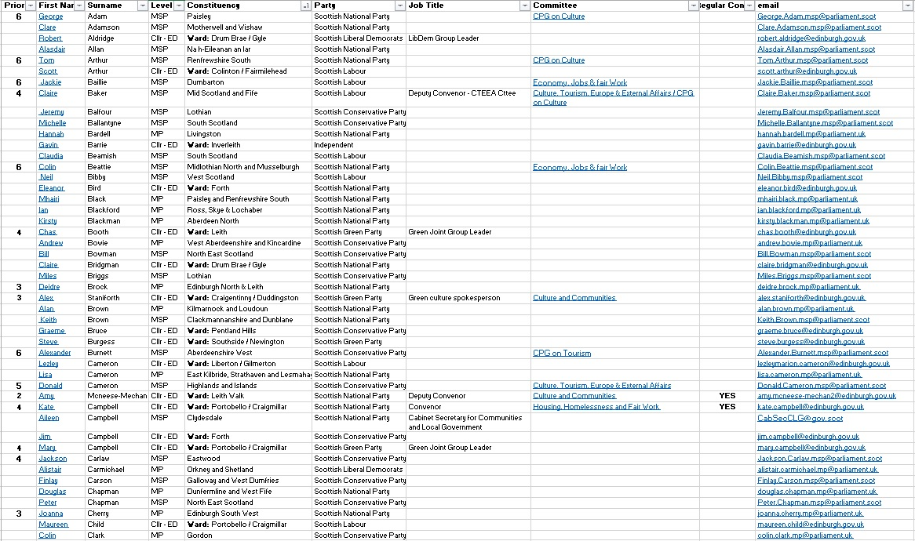
How do we get to them

Slide 30
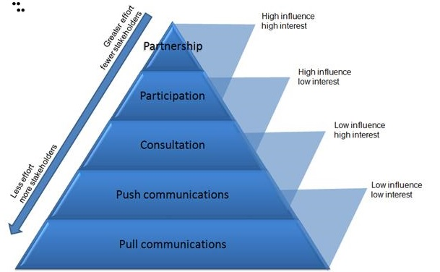
How do we get to them

Slide 31
What’s Our Message?
What Organisations have to hear it?
Who are key decision makers?
When do we get to them?
How do we get to them?

Slide 32
When do we get to them

Slide 33
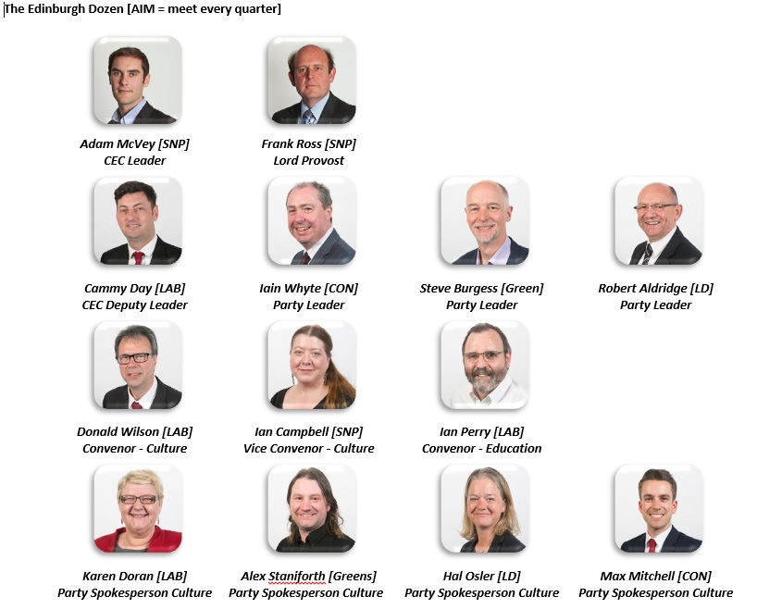
When do we get to them

